Slide 1
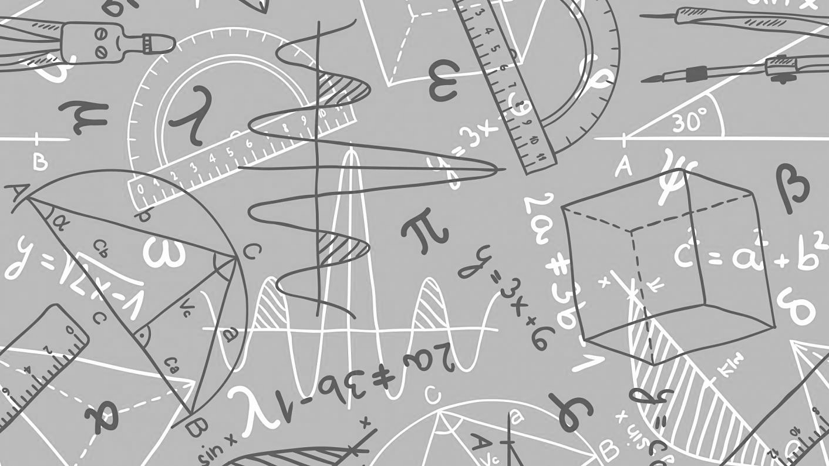
Maths
We can’t wait to meet you…
All the Maths teachers at Springwell Community College are very much looking forward to meeting you, normally during transition weeks you find out about us, we find out about you and together we do some Maths.
Over the summer, we would like you to try and complete the following and when you come to Springwell Community College in September, hand it in to your maths teacher and you will be receive some kudos points for each page that you complete. There are information to read and then some questions for you to try. - don’t worry if you can’t complete it all, just have a go!

Slide 2
The 24 game…
Try this with your family – who is the quickest?
One of our favourite things to do on transition is to play the 24 game. The aim of the game is to be the first person to make the number 24.
For each game you have 4 numbers, you have to use ALL four numbers, you can add, subtract, multiply or divide these to make 24.
Example:
2 2 6 8
To make 24, I can do (8 - 2) x (6 – 2)
8 -2 = 6
6 -2 = 4
6 x 4 = 24
Now it’s your turn, the 24 cards are below they get harder as you go through.
One Dot - Easiest

Slide 3
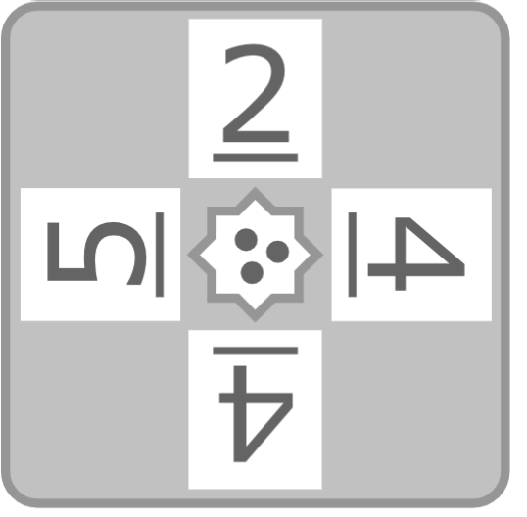
The 24 game…
two Dot - medium
three Dot - harder

Slide 4
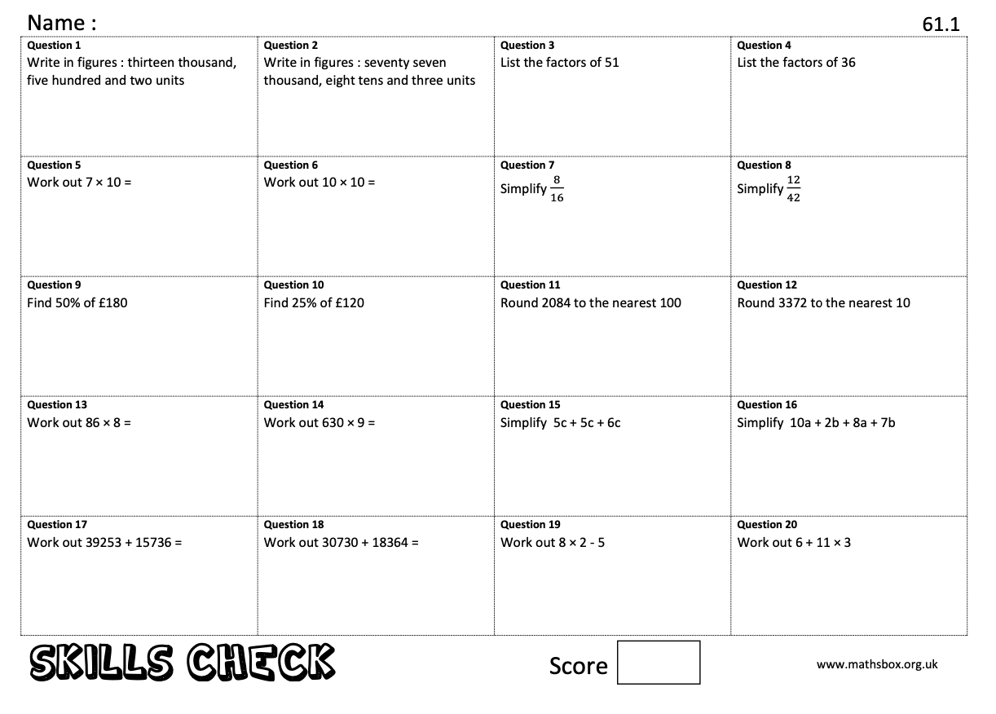
Key Skills…
When you get to a page like this, spend 10 minutes completing
the skills check questions based on topics from Y6.
One famous mathematician is Fibonacci who was an Italian man who studied math and theories back in the 11th century. He discovered a pattern called the Fibonacci sequence. It's a series of numbers that starts with 0 and 1, and each number after is found by adding the two previous numbers (0, 1, 1, 2, 3, 5…)The sequence just keeps going on and on.
Can you find the first 10 numbers in the sequence?

Slide 5
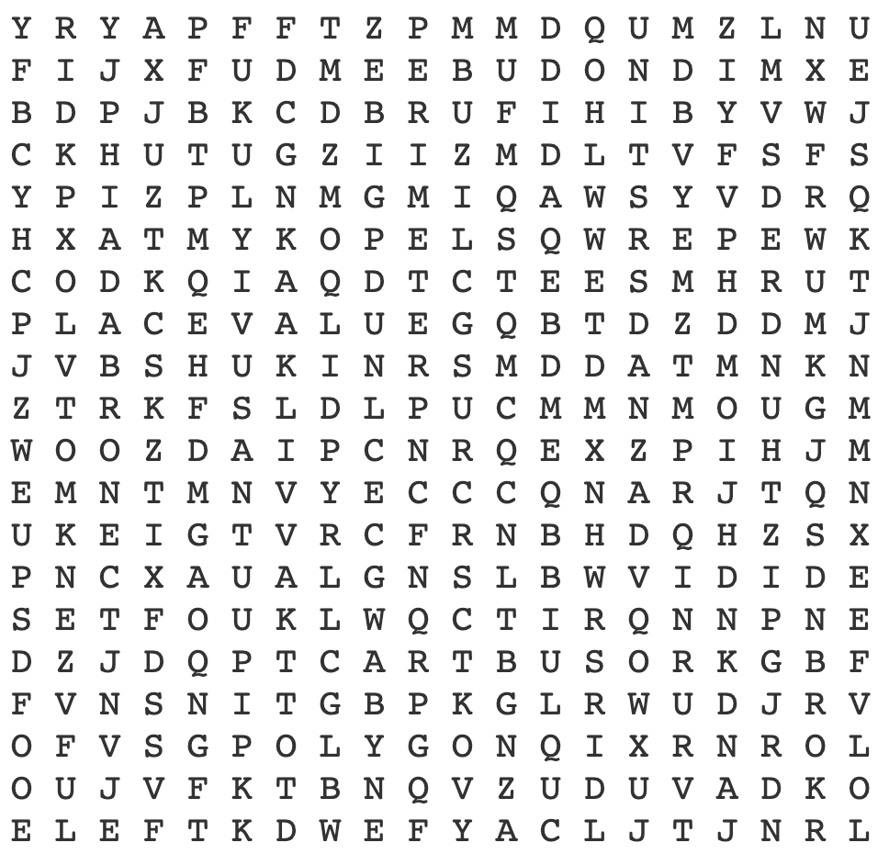
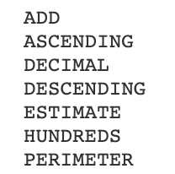
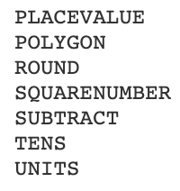
Maths Keywords…
During every Maths lesson you will be asked to write some maths keywords down in your book, we have a special section in books for you to do this. Can you find all the keywords you will need for your first half term at Springwell Community College?
Another famous mathematician was Leonhard Euler (pronounced Oiler) (April 15, 1707 – September 7, 1783). He was a Swiss mathematician and physicist. He spent most of his life in Russia and Germany. Euler made important discoveries in fields like calculus and topology. He also made many of the words used in math today.

Slide 6
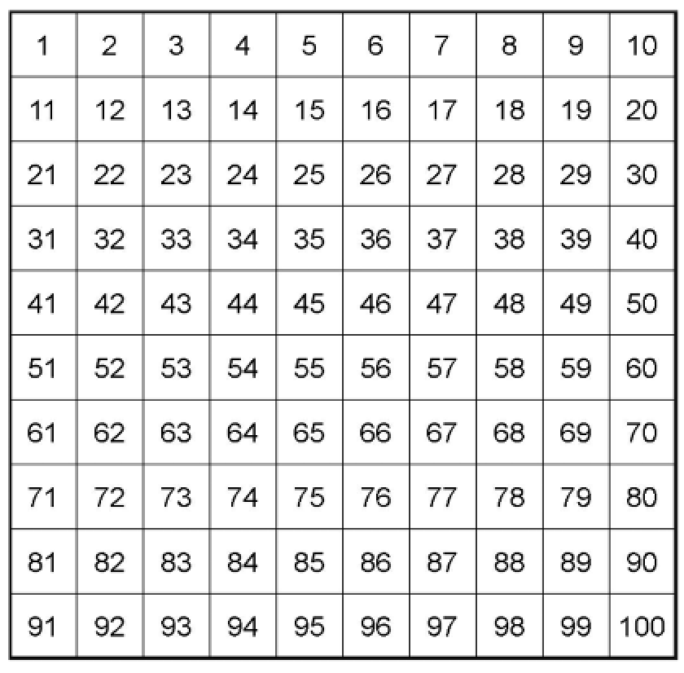
Guess the number from the clues

Slide 7
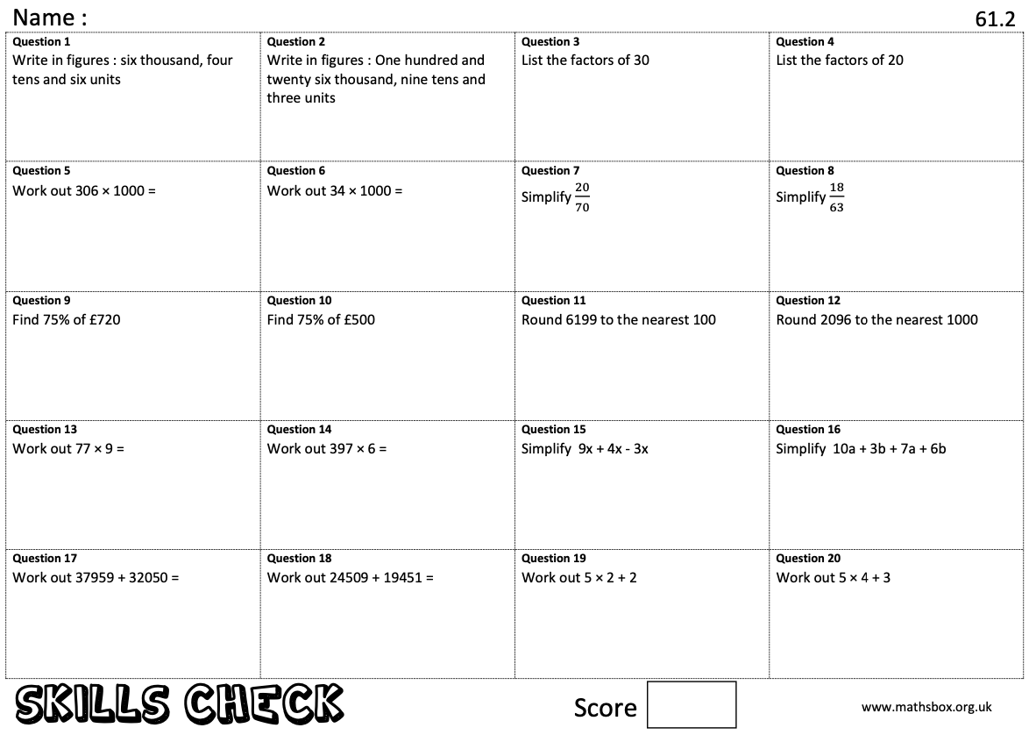
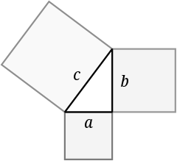
Key Skills…
When you get to a page like this, spend 10 minutes completing
the skills check questions based on topics from Y6.
Pythagoras of Samos was a famous Greek mathematician and philosopher (c. 570 – c. 495 BC). He is known best for the proof of the important Pythagorean theorem, which is about right angled triangles. He started a group of mathematicians, called the Pythagoreans, who worshiped numbers and lived like monks.
Can you find out what the Pythagorean theorem is? You will use it in Year 9.

Slide 8
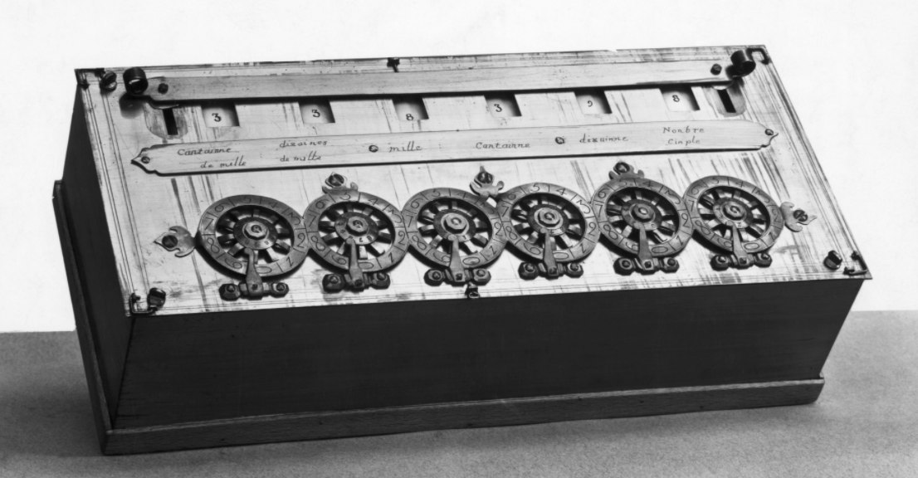
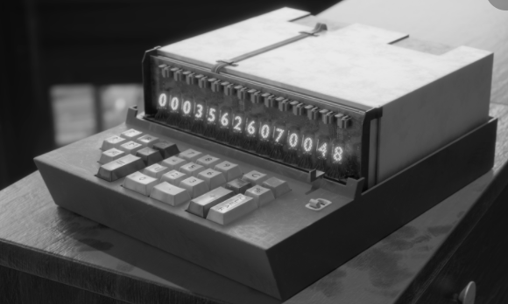
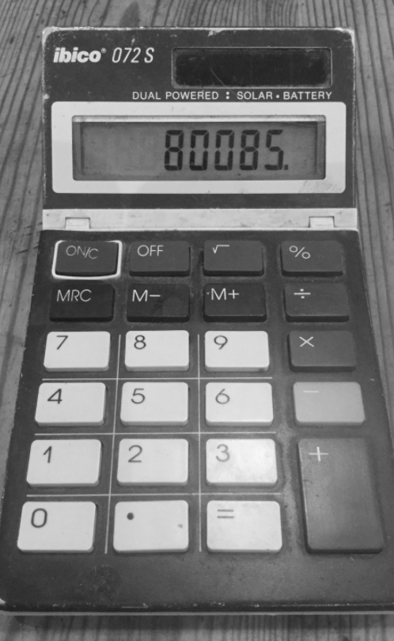
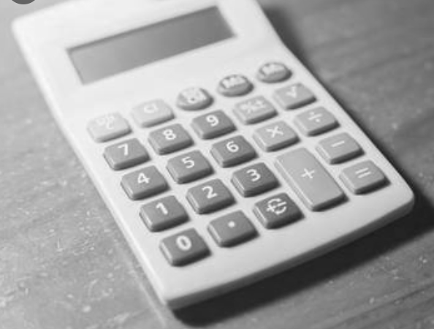
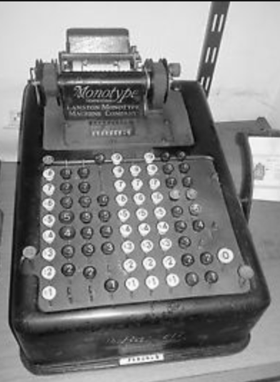
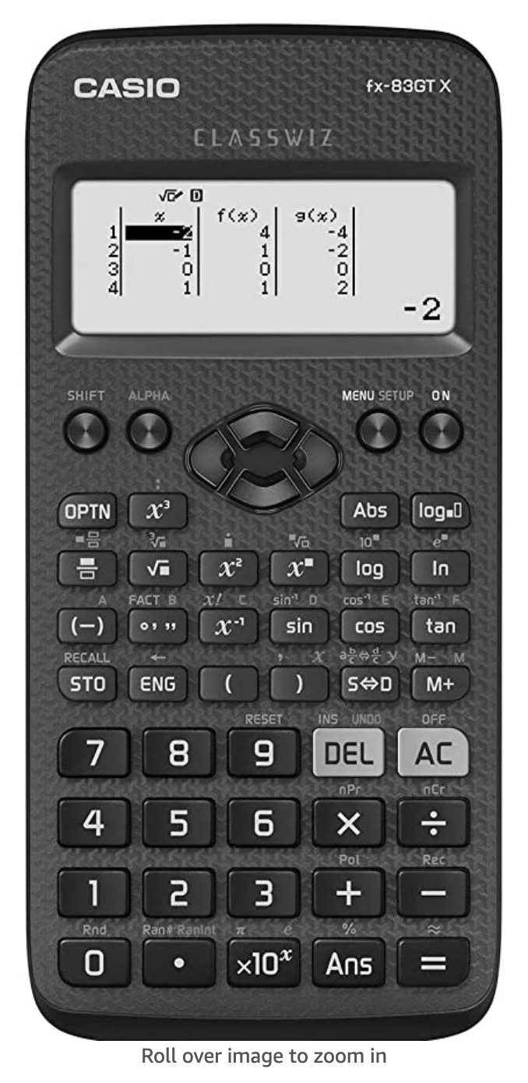
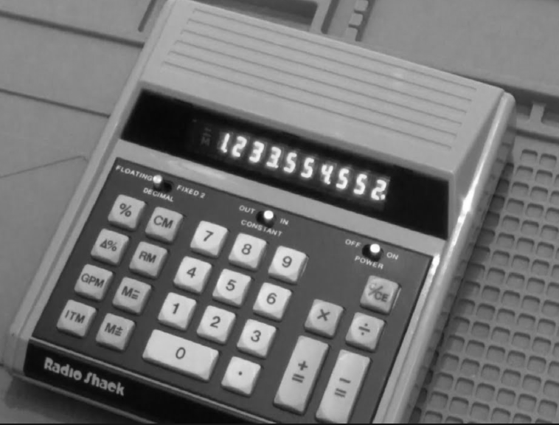
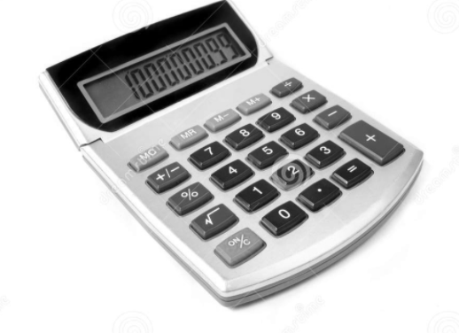
Another famous mathematician was the person who transformed the calculator.
Blaise Pascal, in his short 39 years of life, made many contributions and inventions in several fields. He is well known in both the mathematics and physics fields. In mathematics, he is known for contributing Pascal's triangle and probability theory. He also invented an early digital calculator and a roulette machine.
Pascal’s calculator
The calculator we use in school
The modern calculator can now be found everywhere, both mini and large versions and is embedded into devices such as laptops and mobile phones. How many devices that have calculators can you find in your house?

Slide 9
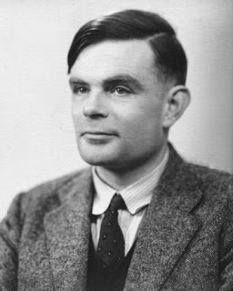
Code Breaking…
Alan Turing
Alan Turing was a British mathematician. He made major contributions to the fields of mathematics, computer science, and artificial intelligence. He worked for the British government during World War II, when he succeeded in breaking the secret code Germany used to communicate.
In September 1939 Great Britain went to war against Germany. During the war, Turing worked at the Government Code and Cypher School at Bletchley Park. Turing and others designed a code-breaking machine known as the Bombe. They used the Bombe to learn German military secrets. By early 1942 the code breakers at Bletchley Park were decoding about 39,000 messages a month. At the end of the war, Turing was made an Officer of the Most Excellent Order of the British Empire.
A | B | C | D | E | F | G | H | I | J | K | L | M
55 | 47 | 84 | 10 | 9 | 75 | 59 | 64 | 32 | 15 | 23 | 50 | 26
N | O | P | Q | R | S | T | U | V | W | X | Y | Z
80 | 63 | 19 | 3 | 27 | 30 | 21 | 92 | 18 | 35 | 99 | 69 | 199
Can you crack the code to reveal a message?
52$÷$ 2 =
44 + 11 =
54 – 33 =
8 x 8 =
17 + 13 =
64 $÷$ 2 =
44 - 14 =
25 x 3 =
9² + 11 =
113 – 33 =
Can you make up some calculations to spell out your name using the same code breaker grid?
Can you make up your own message for a friend to decode?
Notes:
EDIT EDIT EDIT **********

Slide 10
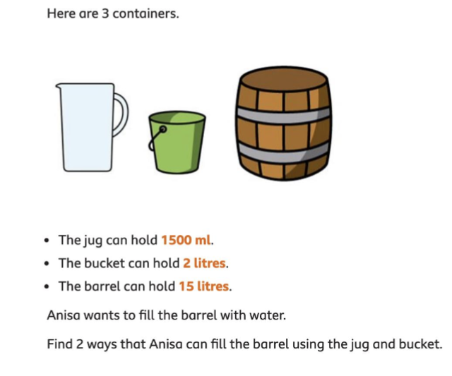
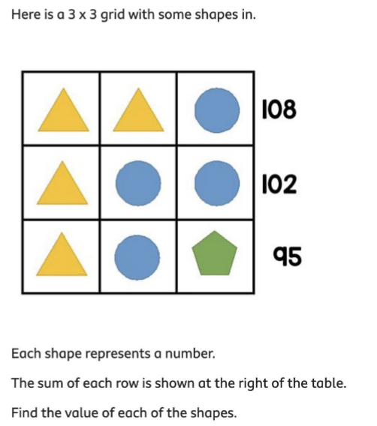
Maths Challenges…
Can you solve all the Maths challenges?
They get more difficult as you get them..

Slide 11
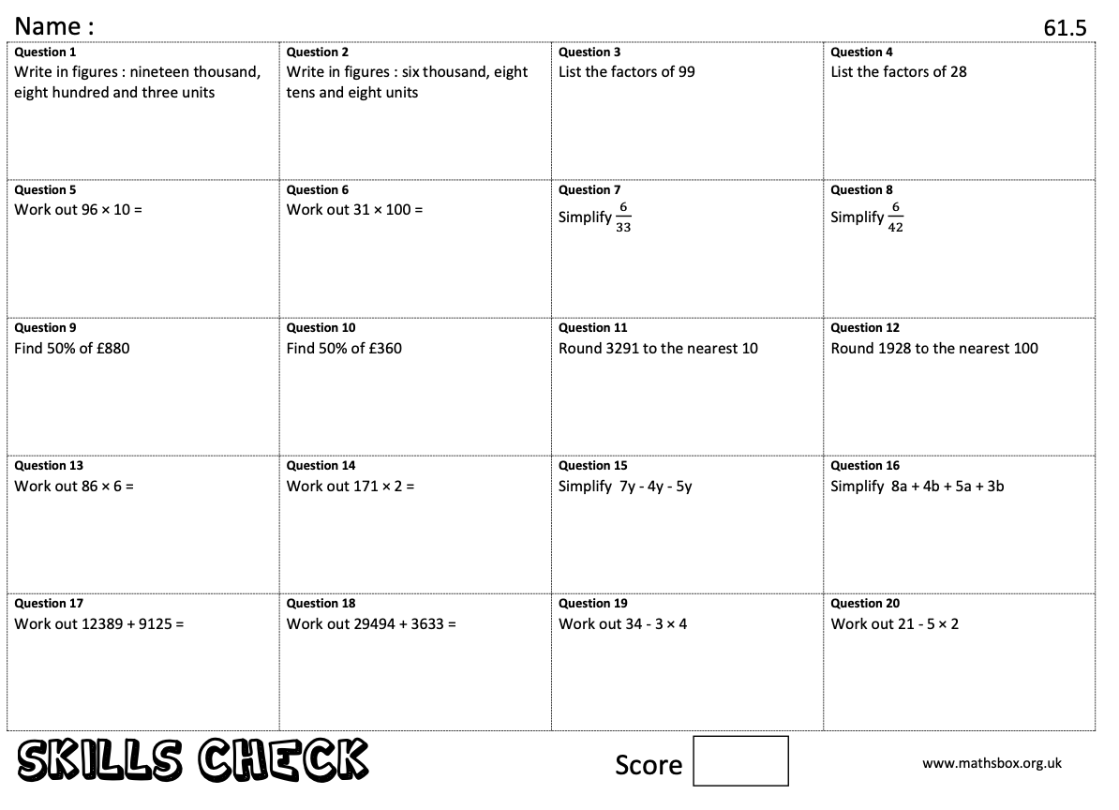
Key Skills…
When you get to a page like this, spend 10 minutes completing
the skills check questions based on topics from Y6.
Ramanujan
Srinivasa Ramanujan
born December 22, 1887 in Erode, India
died April 26, 1920 in Kumbakonam.
He was an Indian mathematician whose contributions to the theory of numbers include pioneering discoveries of the properties of the partition function.

Slide 12
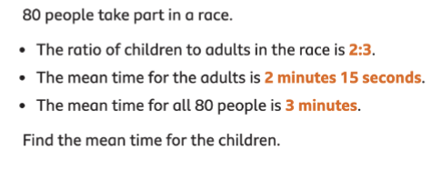
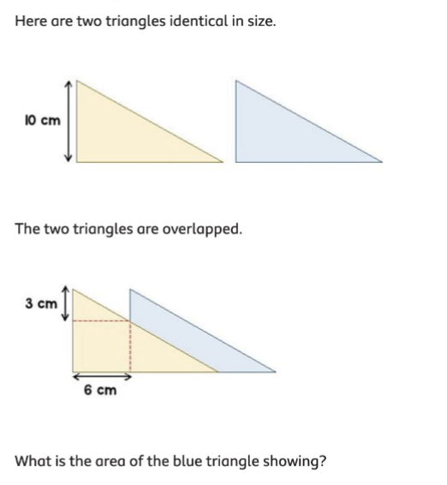
Maths Challenges…
Can you solve all the Maths challenges?
They get more difficult as you get them..

Slide 13
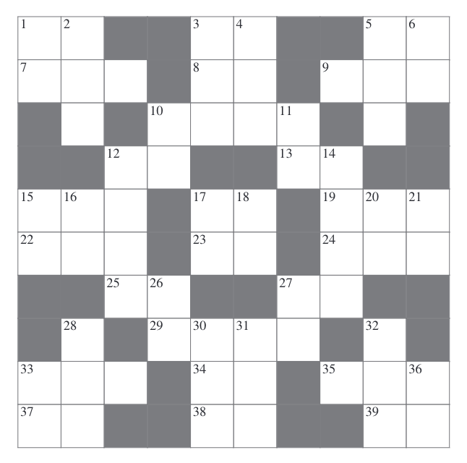
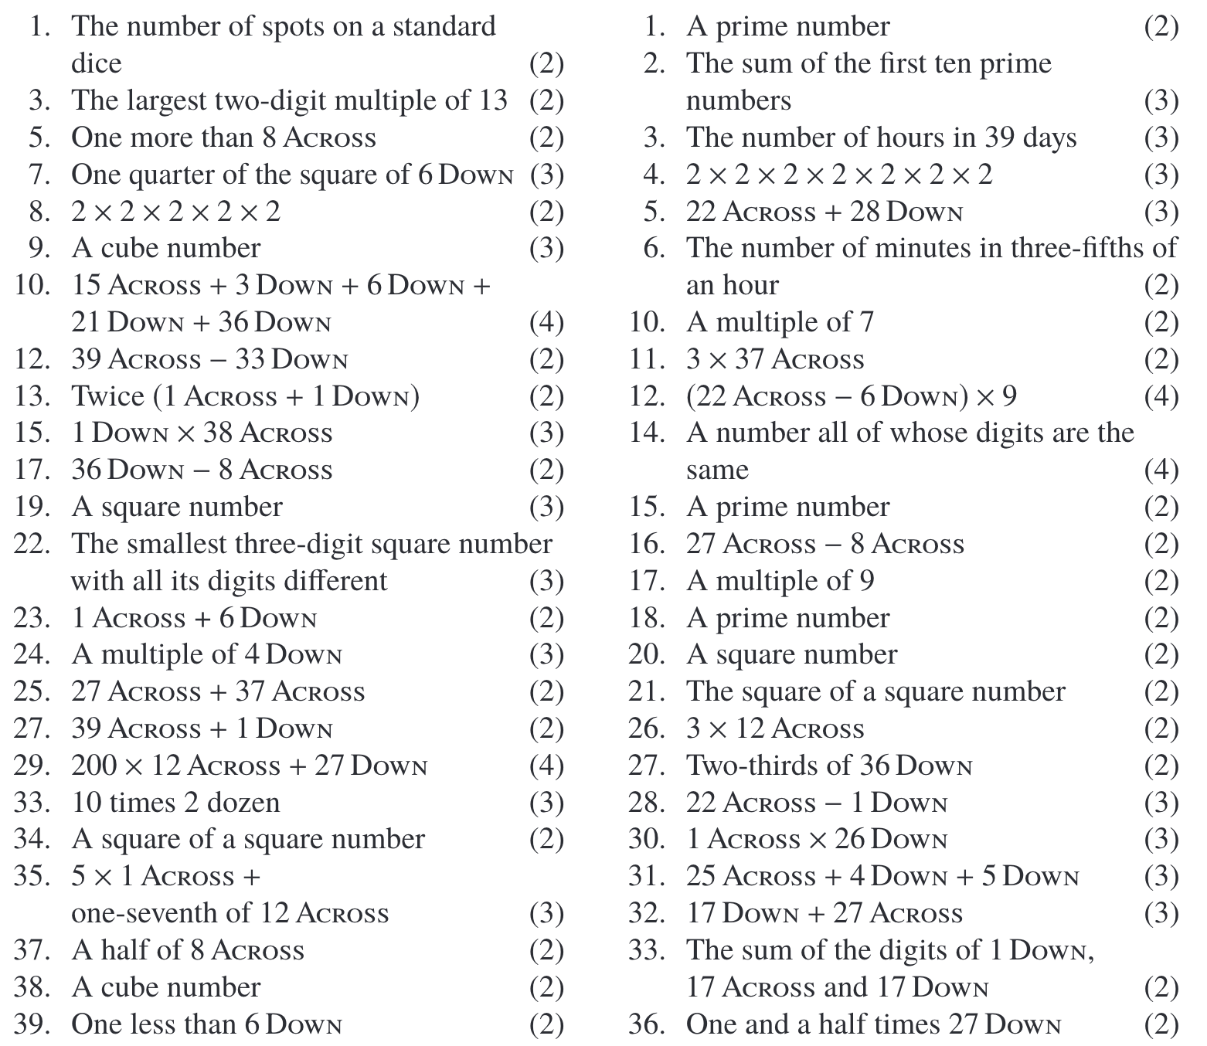
Cross Number…
Use the questions below to complete the cross number.
2
1
Across
down

Slide 14
Some more information on famous mathematicians………..did you know that………
Isaac Newton is considered one of the most important scientists in history. Even Albert Einstein said that Isaac Newton was the smartest person that ever lived. During his lifetime Newton developed the theory of gravity, the laws of motion (which became the basis for physics ), a new type of mathematics called calculus, and made breakthroughs in the area of optics such as the reflecting telescope.
Archimedes of Syracuse was a Greek mathematician, physicist, engineer, inventor, and astronomer. Although few details of his life are known, he is regarded as one of the leading scientists in classical antiquity. Generally considered the greatest mathematician of antiquity and one of the greatest of all time.
It is believed Archimedes was born 287 BC in Syracuse in Sicily, but we don't know his exact birth date. Archimedes was killed by a Roman soldier when the Romans were conquering Syracuse.; Archimedes didn't invent the simple machine called the lever, but he helped explain how the lever works.
Archimedes was an inventor. He made mathematical discoveries as he solved everyday problems. He invented machines to move heavy objects, carry water, and fight battles. Archimedes recorded his discoveries so that others could learn from them.

